Slide 1
Second Parent Meeting
China Trip___ Washington Technology Magnet School
Date: Jan. 29, 2015 Thursday
Place: Washington, room 2408
Time: 4 – 5 pm
Trip participants and their parents / guardians

Slide 2
Report since first parent meeting on Sept. 30, 2014
Accomplishment
Accomplished 2 fund raising events
Successfully completed the travel document and photo copy to ISE
Successfully completed the 20% payment to ISE
Preparation done so far:
a. Home stay letter (accommodation in Beijing has been changed)
b. Reading materials relating to the cities distributed to participants to read
c. Weather information has been posted during March and April on the web site
d. Travel language within China has been posted on the website as well

Slide 3
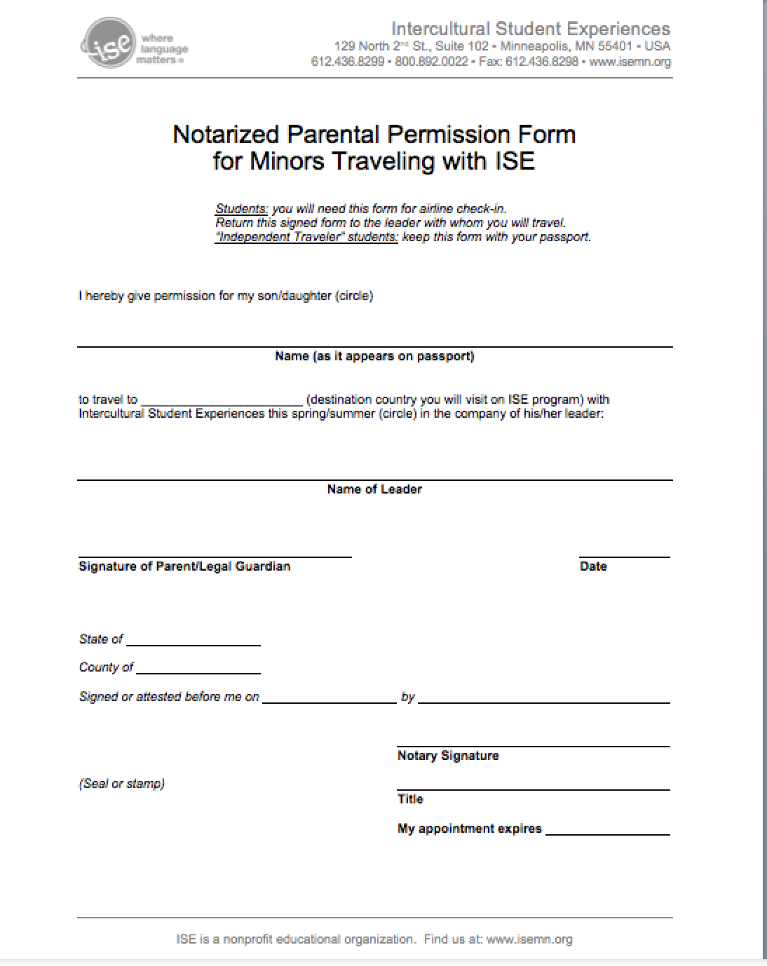

Slide 4
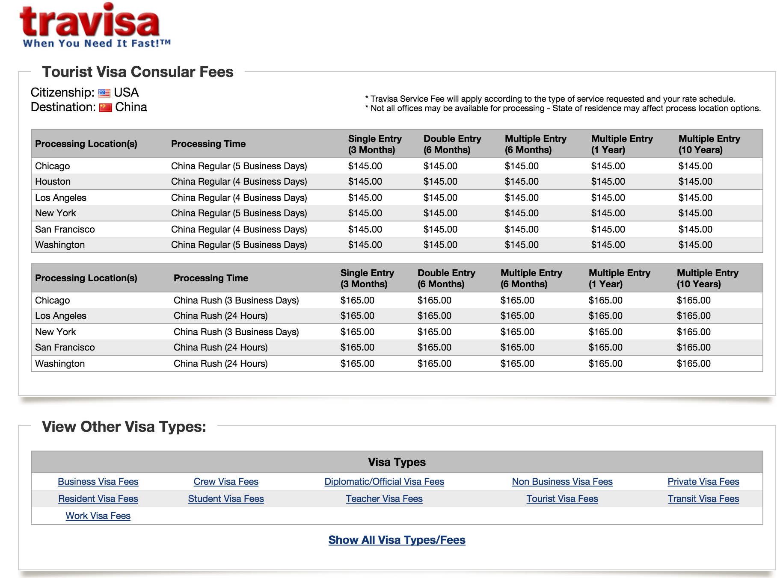

Slide 6
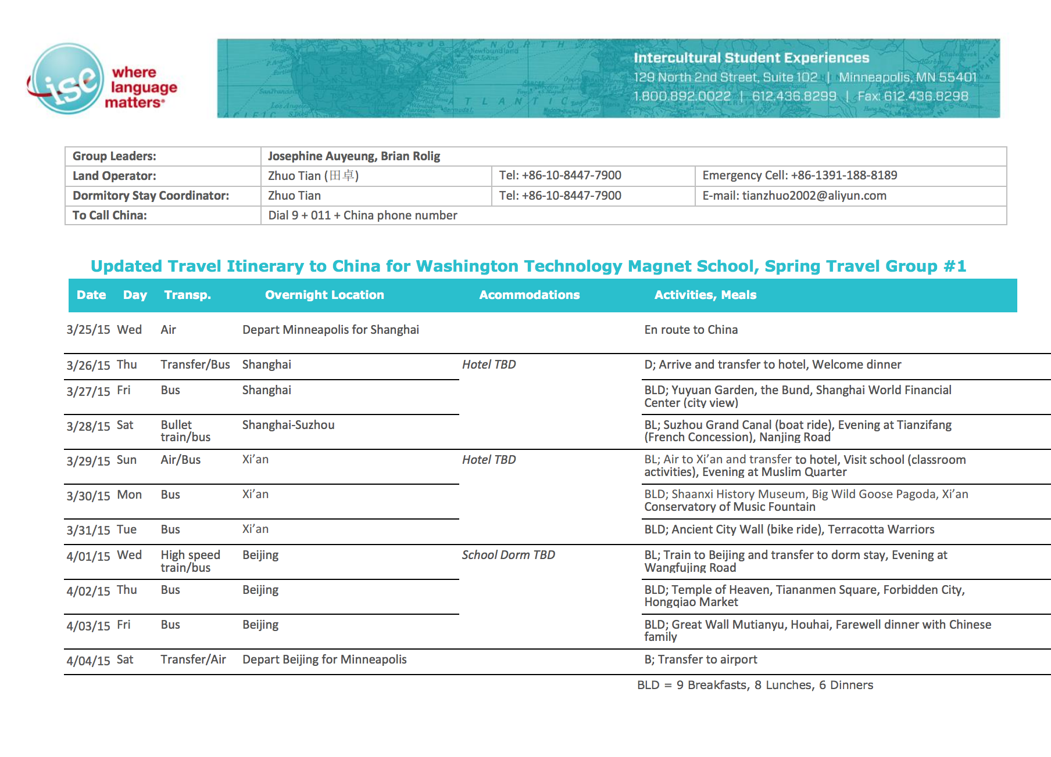

Slide 7
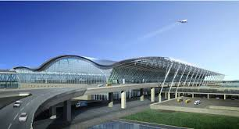
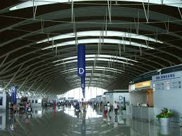
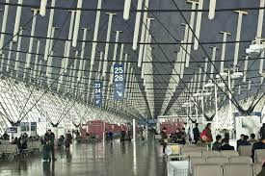
Shanghai Airport
3/26

Slide 8
Yuyuan Garden
3/27

Slide 9
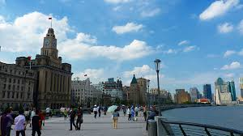
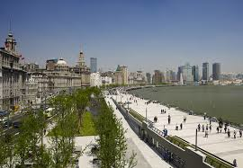
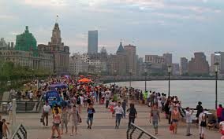
The Bund
3/27

Slide 10
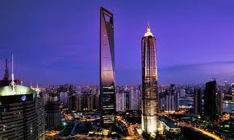
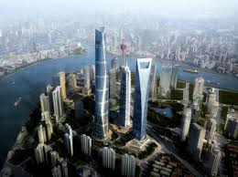
Shanghai Financial Center
3/27

Slide 11
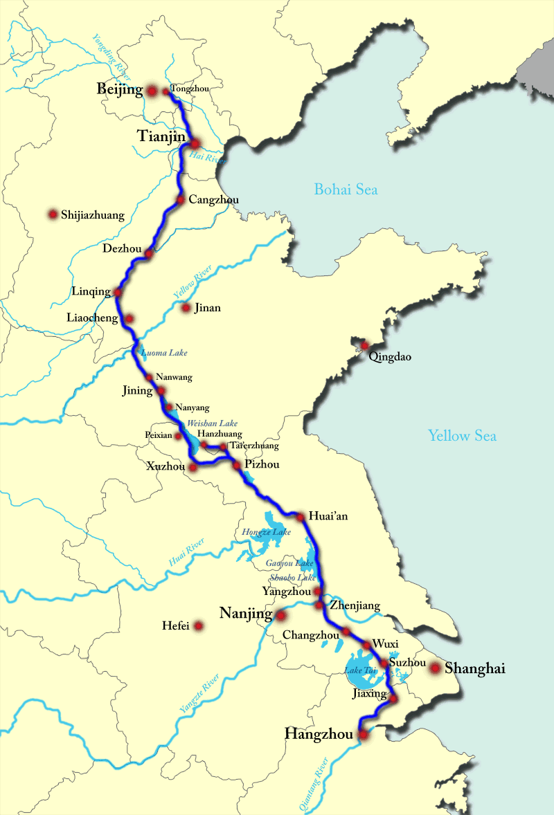
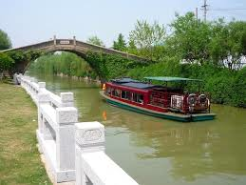
3/28
Boat ride
Suzhou Grand Canal

Slide 12
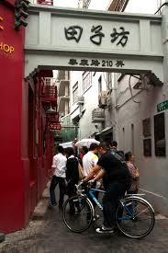
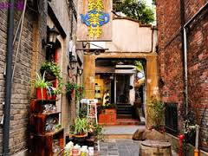
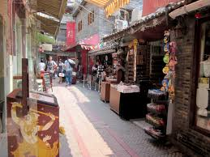
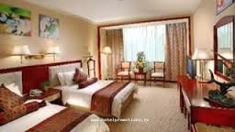
French Concession
Tianzifang
3/28

Slide 13
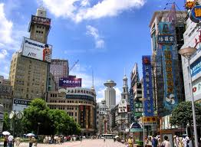
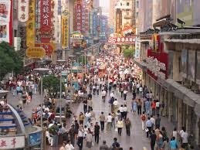
3/28
Dinner and visit

Slide 14
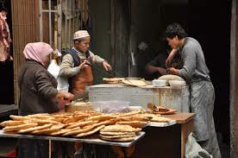
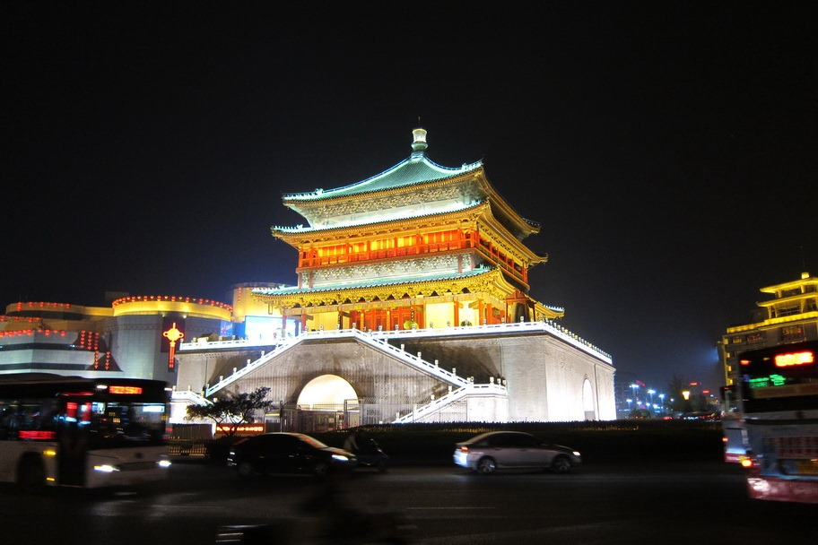
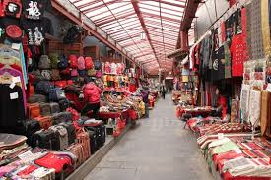
3/29 air to Xian
Visit Muslin Quarter--evening
dinner
http://theselfishyears.com/2013/04/24/the-delicious-food-of-the-hui-muslim-quarter/

Slide 15
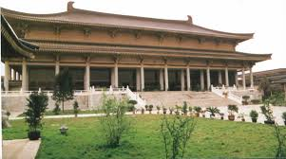
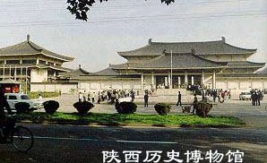
3/30
Visit
Shanxi History Museum
http://www.chinatouronline.com/china-travel/xian/xian-attractions/Shaanxi-History-Museum_37.html

Slide 16
To Xian
3/29
Visit School—classroom activities
Waiting for more information
Performance by Washington students

Slide 17
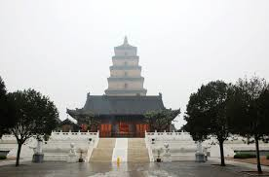
3/30
Wild Goose Pagoda
http://en.wikipedia.org/wiki/Giant_Wild_Goose_Pagoda

Slide 18
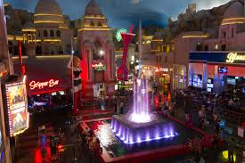
3/30 evening
Xian Conservatory music fountain
http://en.wikipedia.org/wiki/Xi%27an_Conservatory_of_Music

Slide 19
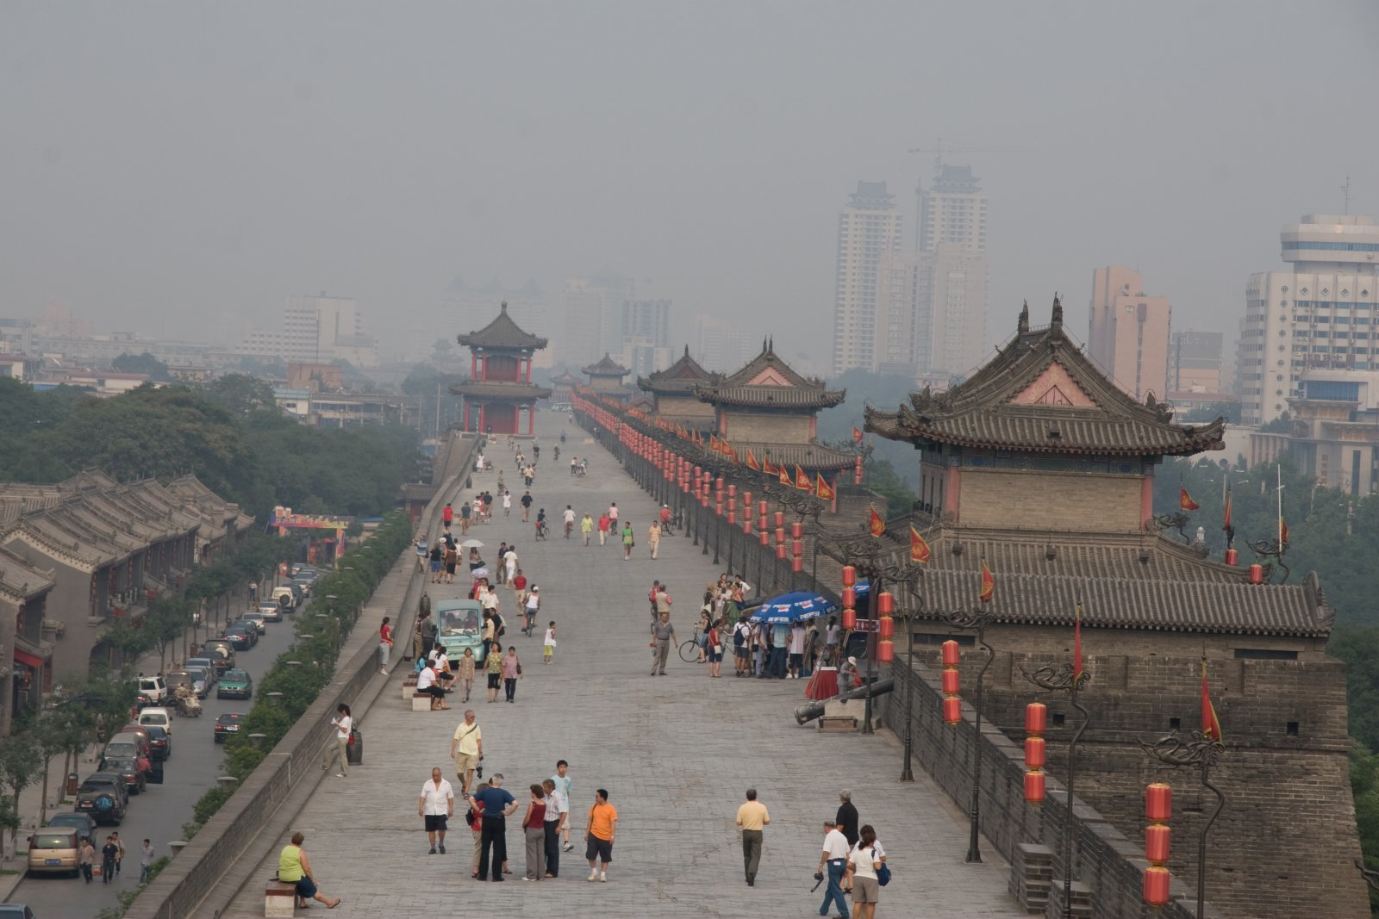
Ancient City wall– bike ride
3/31

Slide 20
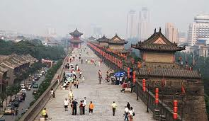
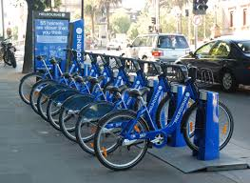
Ancient City Wall__bike ride
3/31

Slide 21
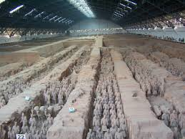
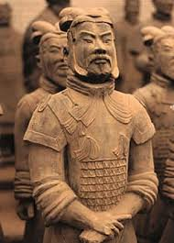
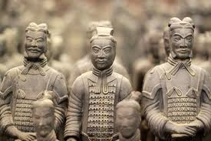
3/31
Terracotta Warrior

Slide 22
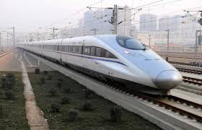
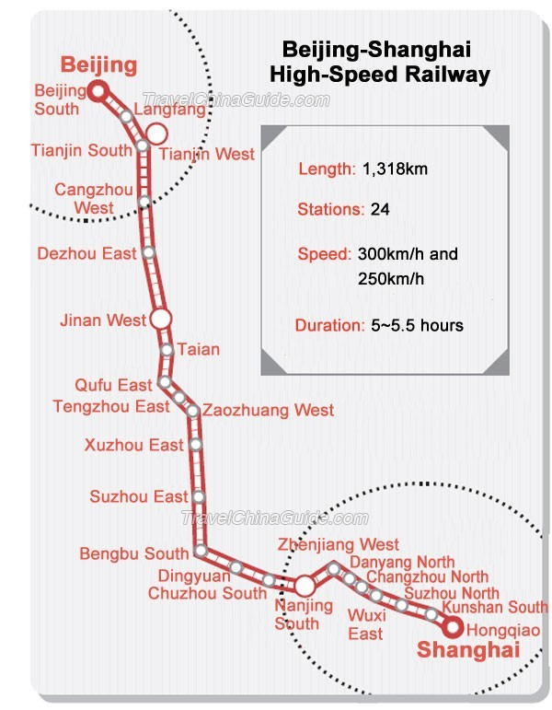
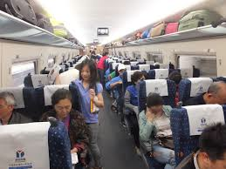
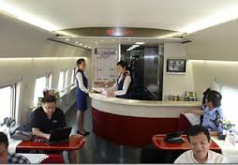
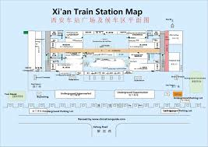
4/1
Train to Beijing and to the dorm

Slide 23
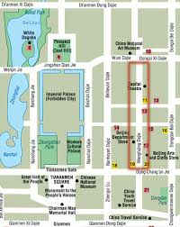
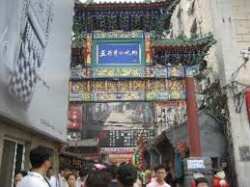
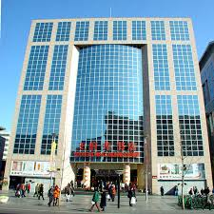
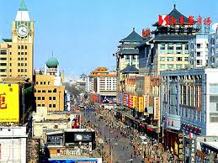
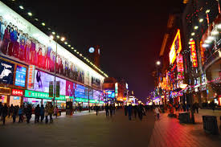
Beijing to dorm first
4/1
Dinner at Wangfujing

Slide 24
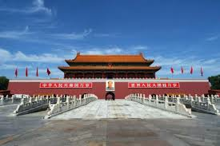
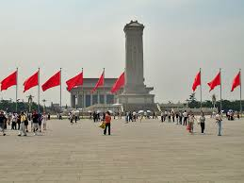
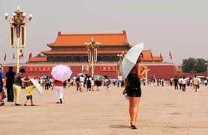
4/2
Tiananmen Square --- Forbidden City

Slide 25
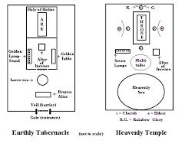
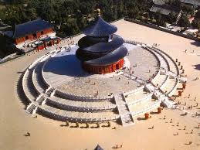
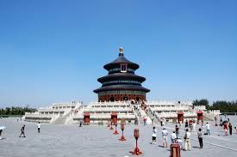
4/2
Heavenly Temple

Slide 26
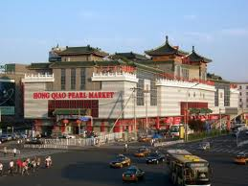
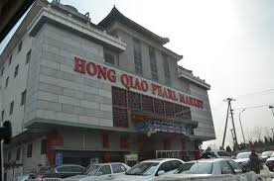
4/2
shopping

Slide 27
4/3
Great Wall
Hou Hai
End with Farewell dinner

Slide 28
4/4
Beijing Airport to US

Slide 29
Planning…..

Slide 30
Attention:

Slide 31
Required Code of Conduct

Slide 32
Document and get ready
Permission ise to travel
Permission for medical treatment oversea
Core insurance
Packing list
Flight information _ not flight detail
Dorm stay info
Visa info
Call chain
Spending money
Phone
Tip
Self added program??
Phone call- call blast system??
Parent encouragement
Performance visit school 2
http://www.isemn.org/languages/start-here/before-your-trip/teacher-workshop/china-programs.html

Slide 33
Alternative for free time…..

Slide 34
It is the school the participants will spend at the dorm of this school.
http://www.shsbnu.net/info/data/resource/2fz/index.html

